Slide 1

GHARDA INSTITUTE OF TECHNOLOGY
MINI PROJECT
SECOND YEAR COMPUTER

Slide 2

TOPIC :
ONLINE EXAMINATION MANAGEMENT SYSTEM

Slide 3

GROUP MEMBERS
NAMES ROLL NO
MAHADIK SIDDHI PRAVIN 35
PATIL NISHA MARUTI 41
NAIR LAXMI VENUGOPAL 40
CHAVAN POOJA SANDEEP 06
SUPERVISOR : PROF P. V. OAK

Slide 4

INTRODUCTION
Online Examination System is a cost-effective, scalable way to convert traditional pen and paper-based exams to online and paperless mode. Candidates can appear for the exam using any desktop, laptop, or mobile device. Exam results can be generated instantly for the objective type of questions.

Slide 5

ABSTRACT
The Java Programming Language is a general-purpose, concurrent, strongly typed, class-based object-oriented language. The purpose of online examination system in Java using NetBeans is to take online test for students in an efficient and systematic manner. It does not waste time on checking the paper manually. It checks the paper online when the student clicks the submit test button the result will immediately display over the screen.

Slide 6

PROJECT DETAILS
Project name: Online examination Management System
Programming Language Used :Java
IDE Tool : NetBeans
Project Type: Desktop Application

Slide 7
ADVANTAGES
1)USER FRIENDLY.
2)ACCURACY IN CHECKING THE ANSWER, CALCULATING RESULT.
3)RESULTS ARE AVAILABLE
INSTANTLY

Slide 8
PROJECT DESIGN
Start page
Instructions page
Questions
Result page
Exit
OBJECTIVES
TO CREATE ONLINE EXAMINATION MANAGEMENT SYSTEM USING JAVA.
TO CALCULATE AUTOMATIC MARKS AFTER THE TEST.

Slide 9
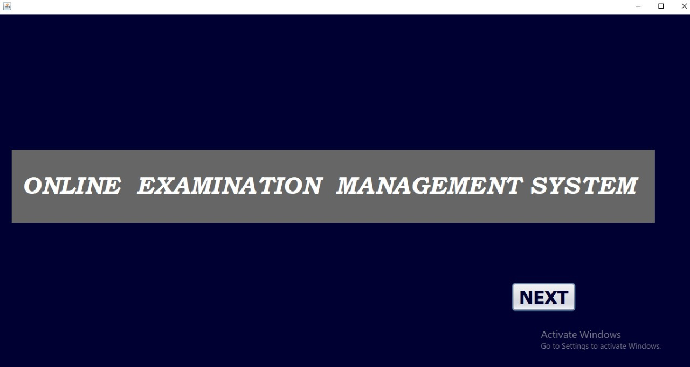
PROJECT DETAILS
Project name: Online examination Management System
Programming Language Used :Java
IDE Tool : NetBeans
Project Type: Desktop Application

Slide 10
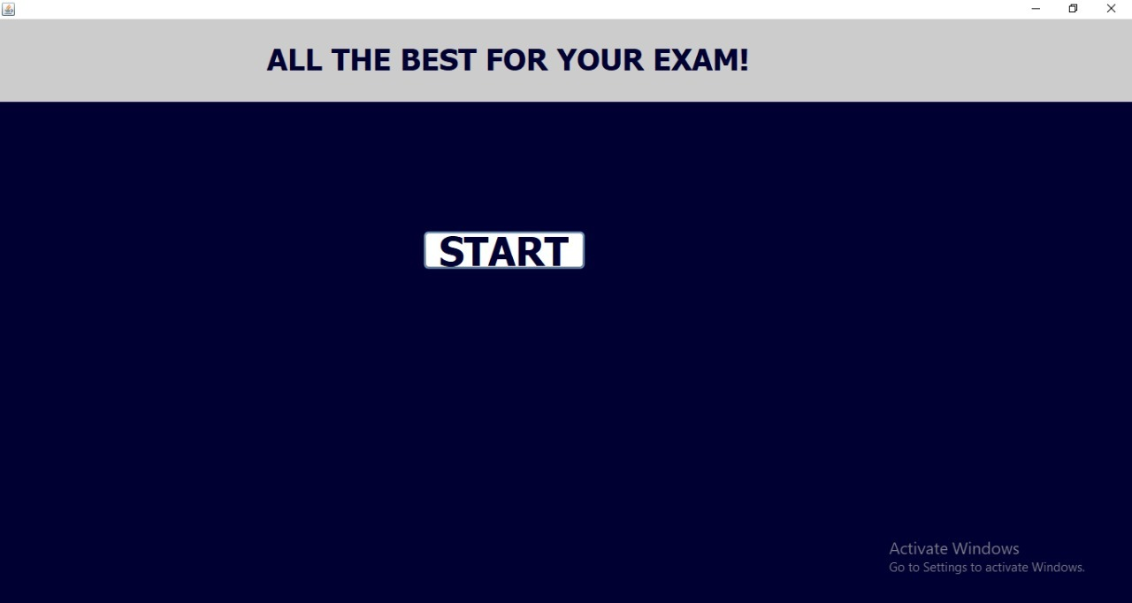
PROJECT DETAILS
Project name: Online examination Management System
Programming Language Used :Java
IDE Tool : NetBeans
Project Type: Desktop Application

Slide 11
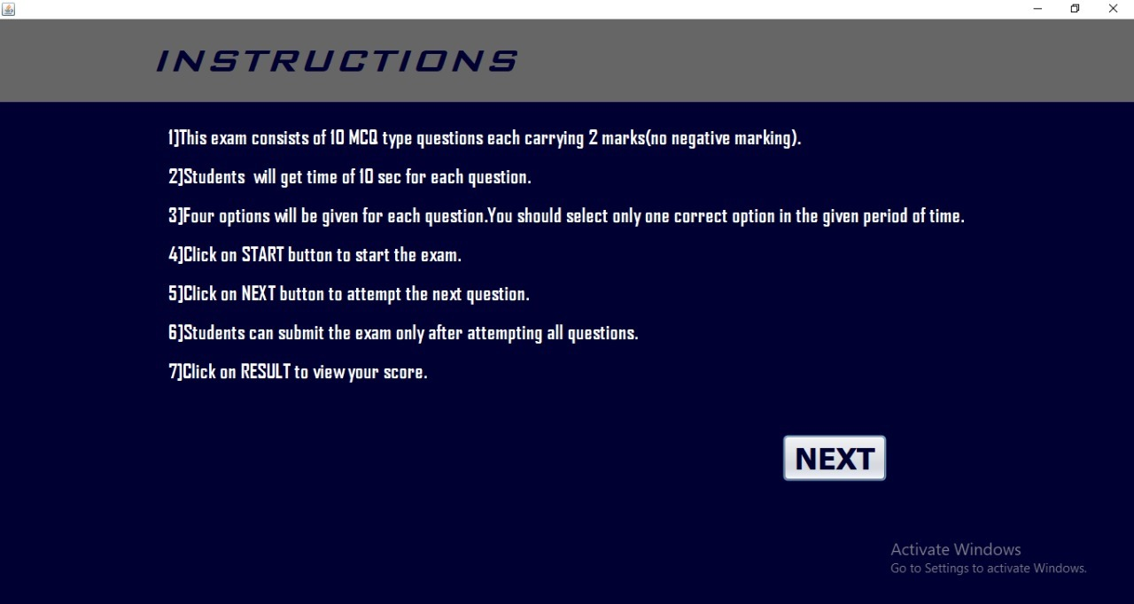
PROJECT DETAILS
Project name: Online examination Management System
Programming Language Used :Java
IDE Tool : NetBeans
Project Type: Desktop Application

Slide 12
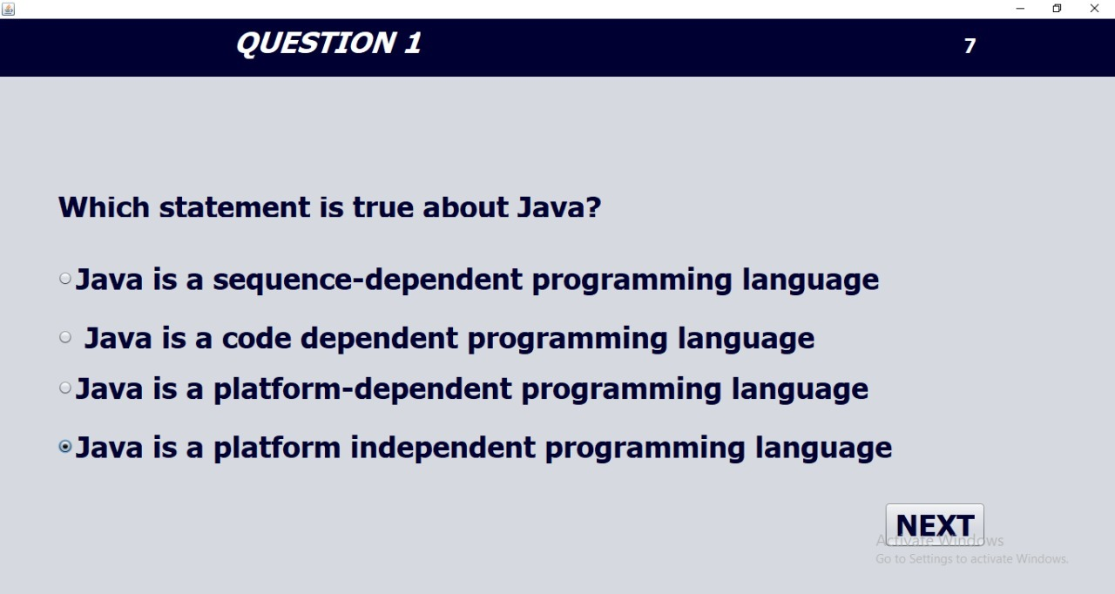
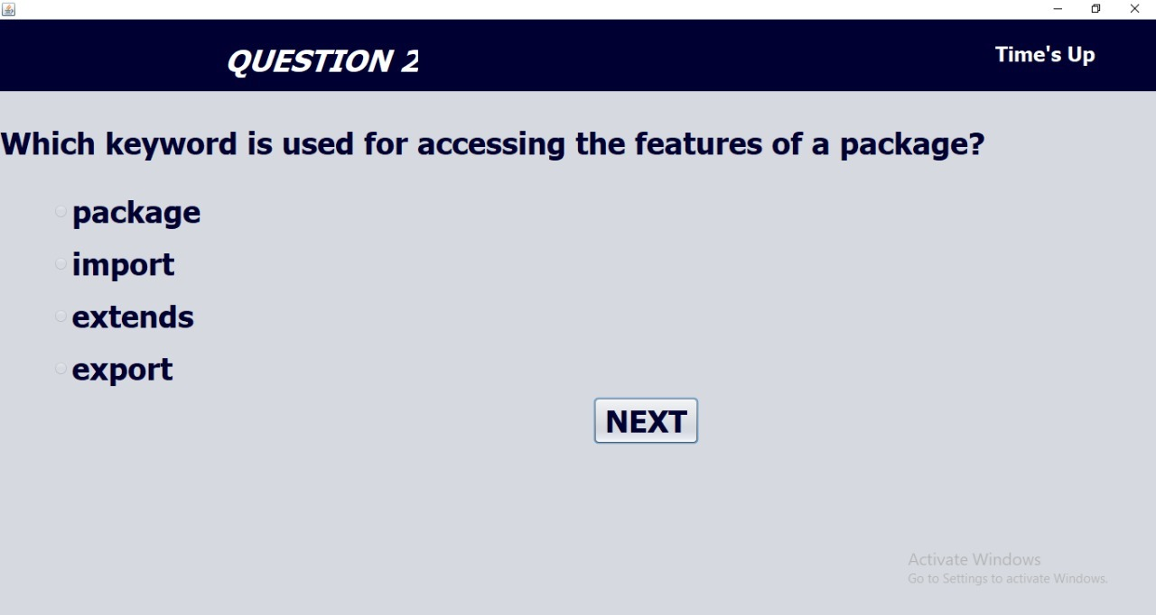
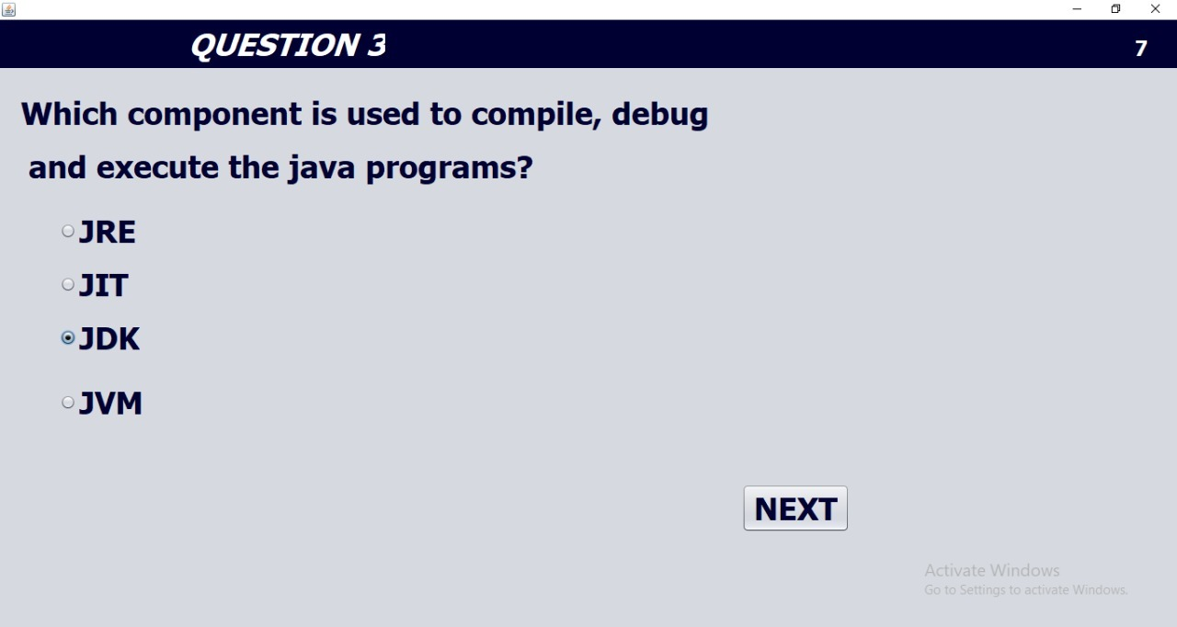
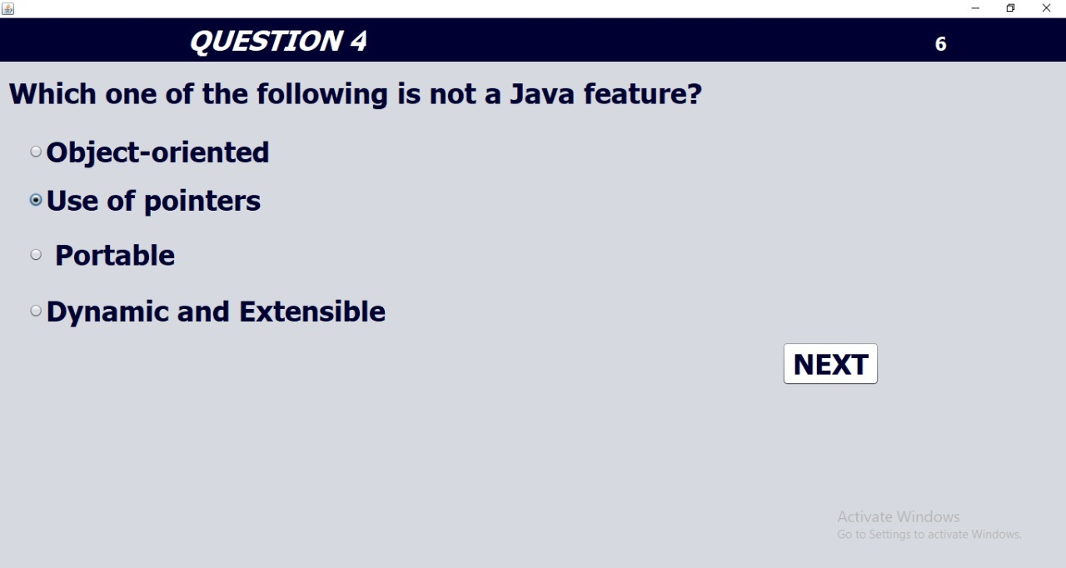
PROJECT DETAILS
Project name: Online examination Management System
Programming Language Used :Java
IDE Tool : NetBeans
Project Type: Desktop Application

Slide 13
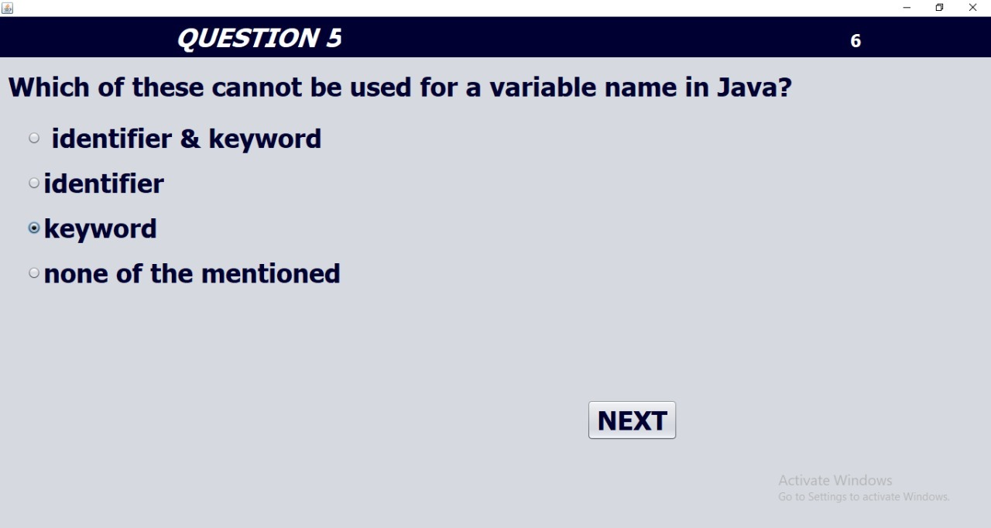
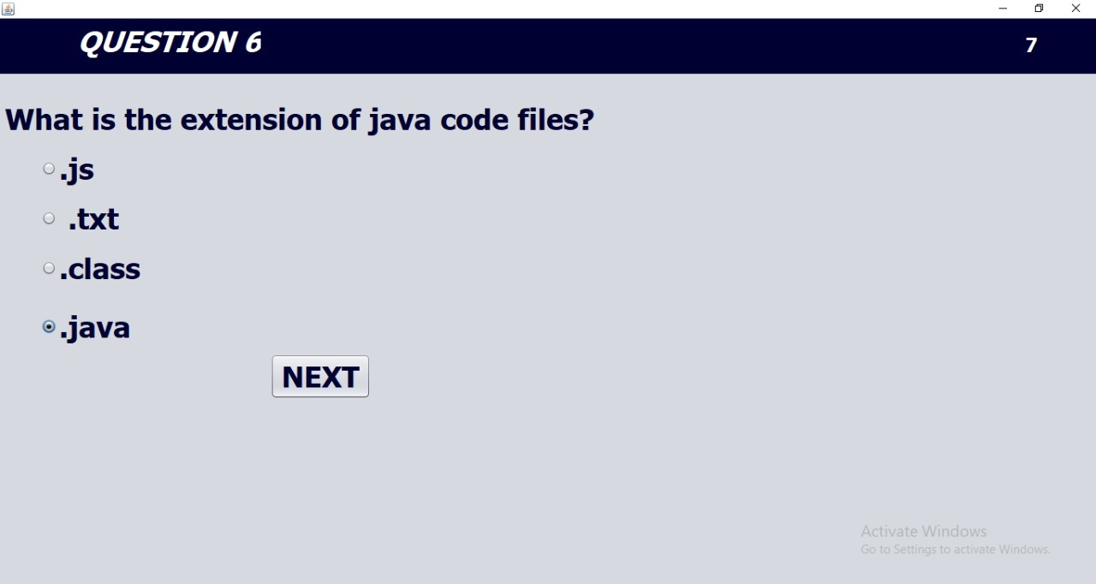
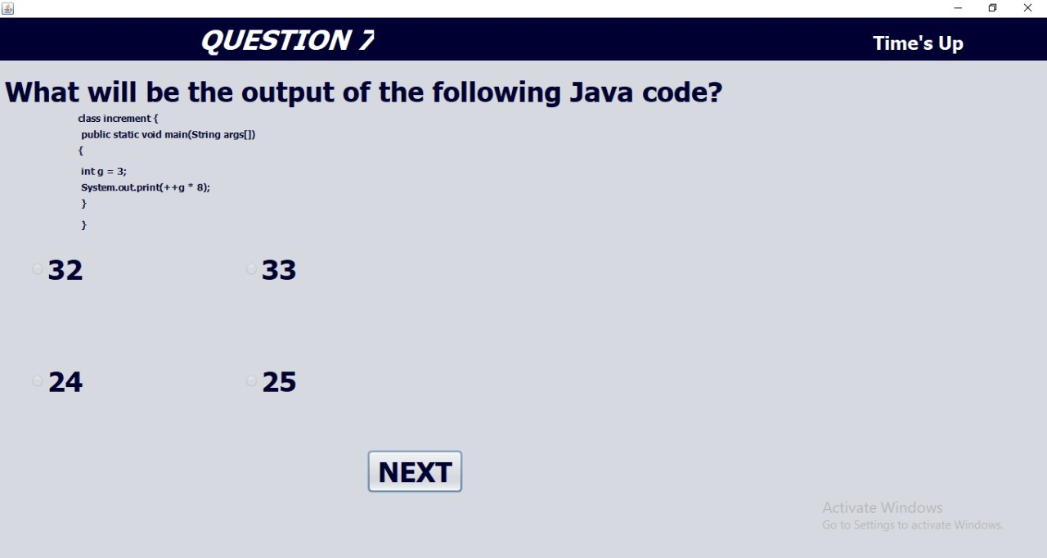
PROJECT DETAILS
Project name: Online examination Management System
Programming Language Used :Java
IDE Tool : NetBeans
Project Type: Desktop Application

Slide 14
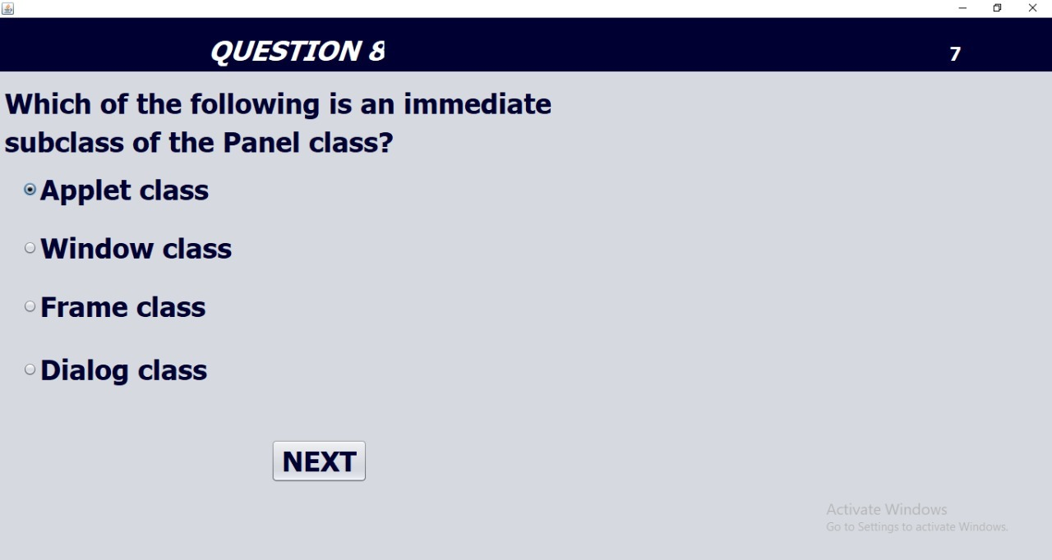
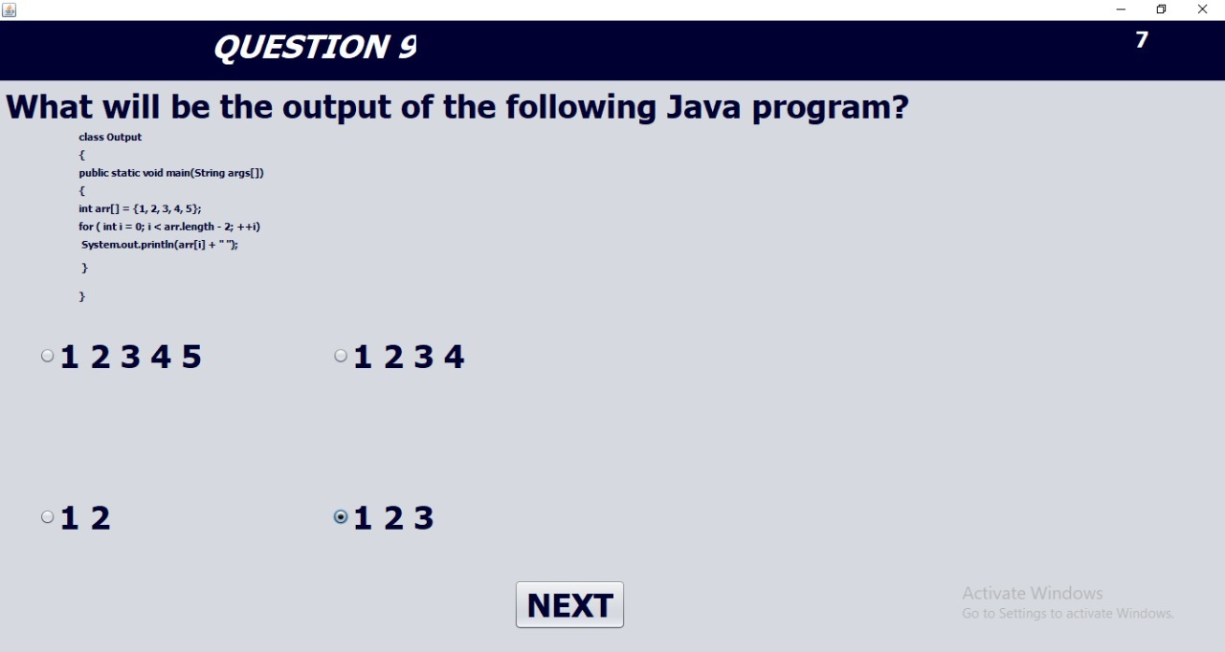
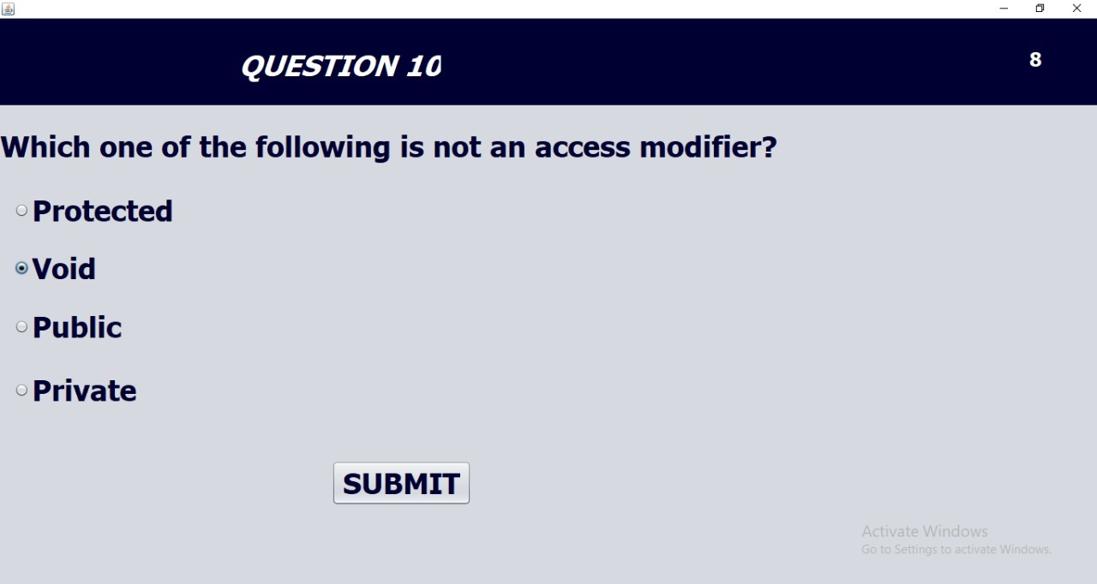
PROJECT DETAILS
Project name: Online examination Management System
Programming Language Used :Java
IDE Tool : NetBeans
Project Type: Desktop Application

Slide 15
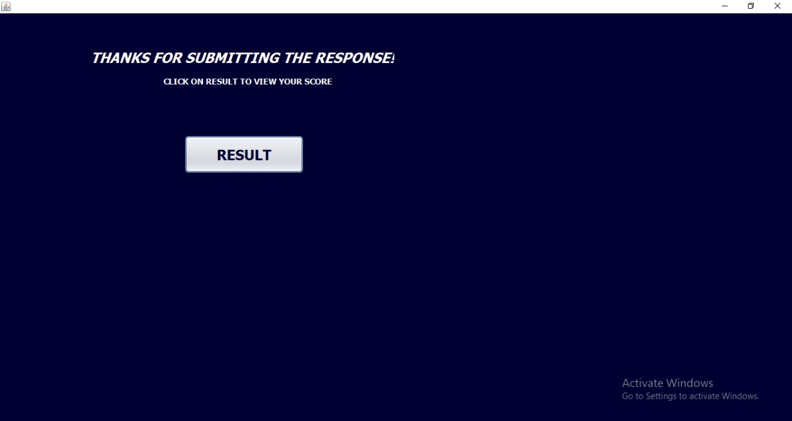
PROJECT DETAILS
Project name: Online examination Management System
Programming Language Used :Java
IDE Tool : NetBeans
Project Type: Desktop Application

Slide 16
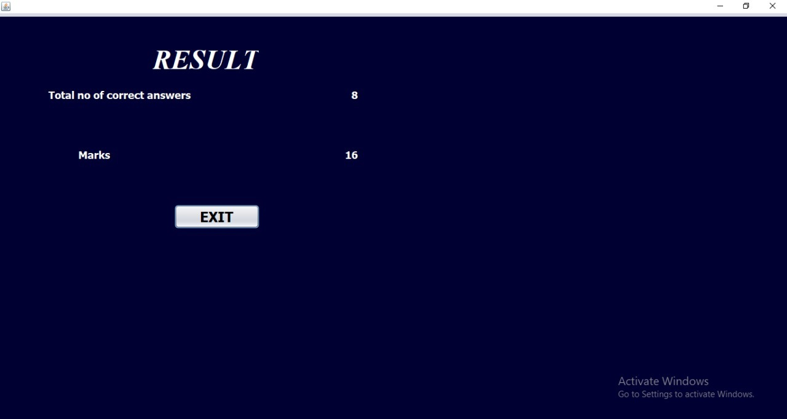
PROJECT DETAILS
Project name: Online examination Management System
Programming Language Used :Java
IDE Tool : NetBeans
Project Type: Desktop Application

Slide 17
PROJECT DETAILS
Project name: Online examination Management System
Programming Language Used :Java
IDE Tool : NetBeans
Project Type: Desktop Application
SCOPE
The Online Examination system is developed or designed for Educational institutes like school, colleges, and private institutes to conduct logic test of their students on regular basis. Can be used anywhere any time as it is
web based application.

Slide 18
PROJECT DETAILS
Project name: Online examination Management System
Programming Language Used :Java
IDE Tool : NetBeans
Project Type: Desktop Application
CONCLUSION
Online examination system is a user friendly system, which is very easy and convenient to use. The system has reached a steady state where all bugs have been eliminated. As far as design is concerned no design is complete ever and there are chances of improvement each moment. there are chances of improvement each moment.

